Slide 1

E health presented by
Riad
Udoy
mahin

Slide 2
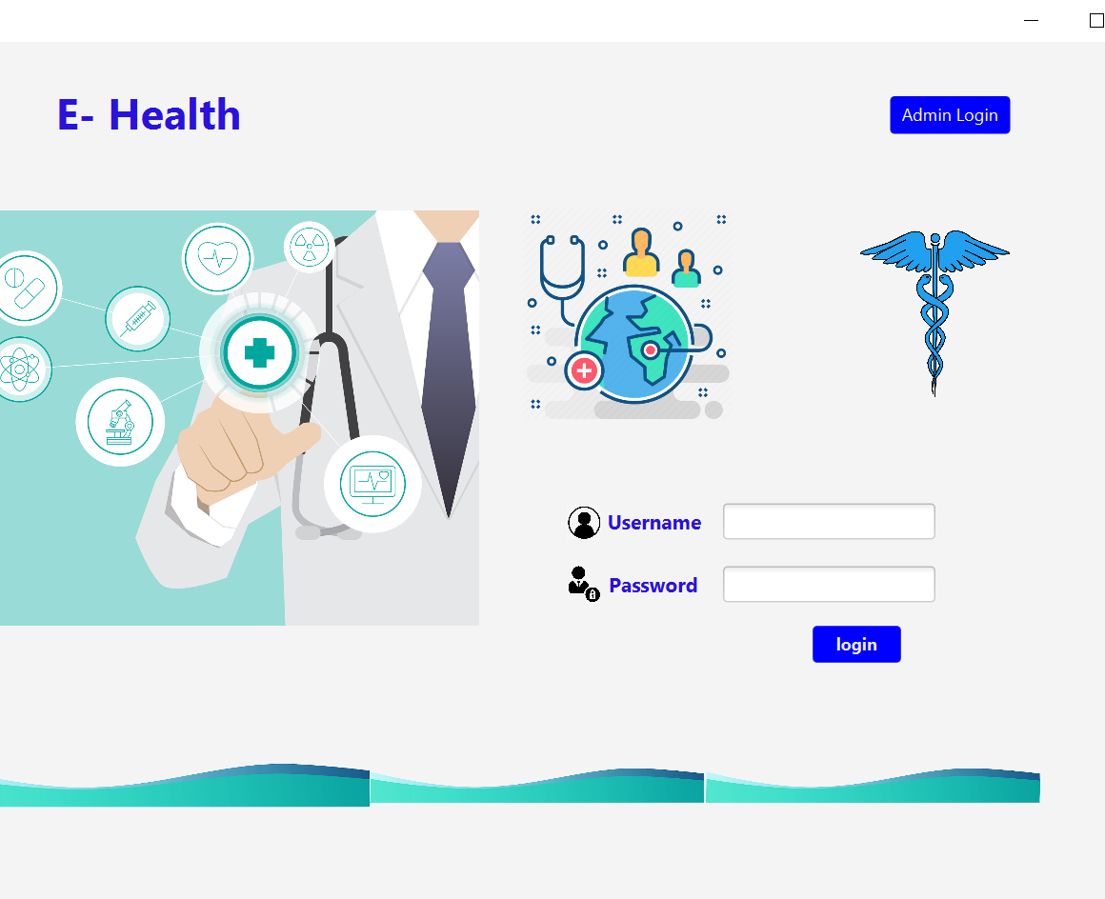
Login Menu
This is the login menu. A user can access the main menu through the login page. There is also a button at the top which is for the admin panel

Slide 3
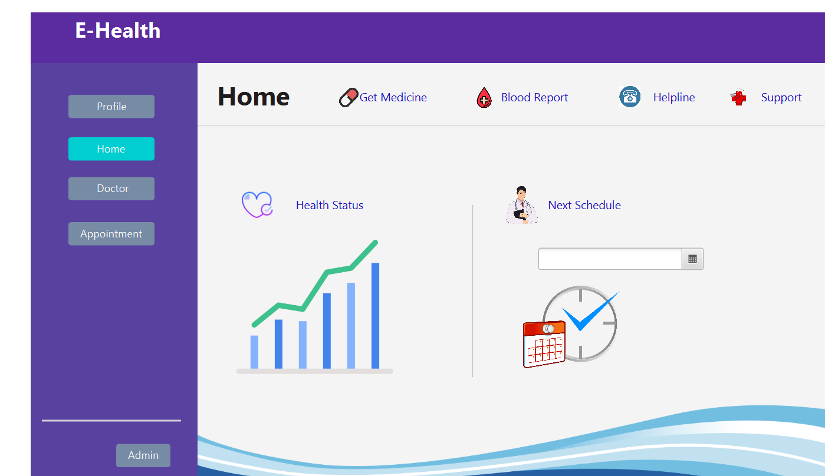
Home menu
Here is the home page. There are some details about the patient and the patient can make schedule for the appointment

Slide 4
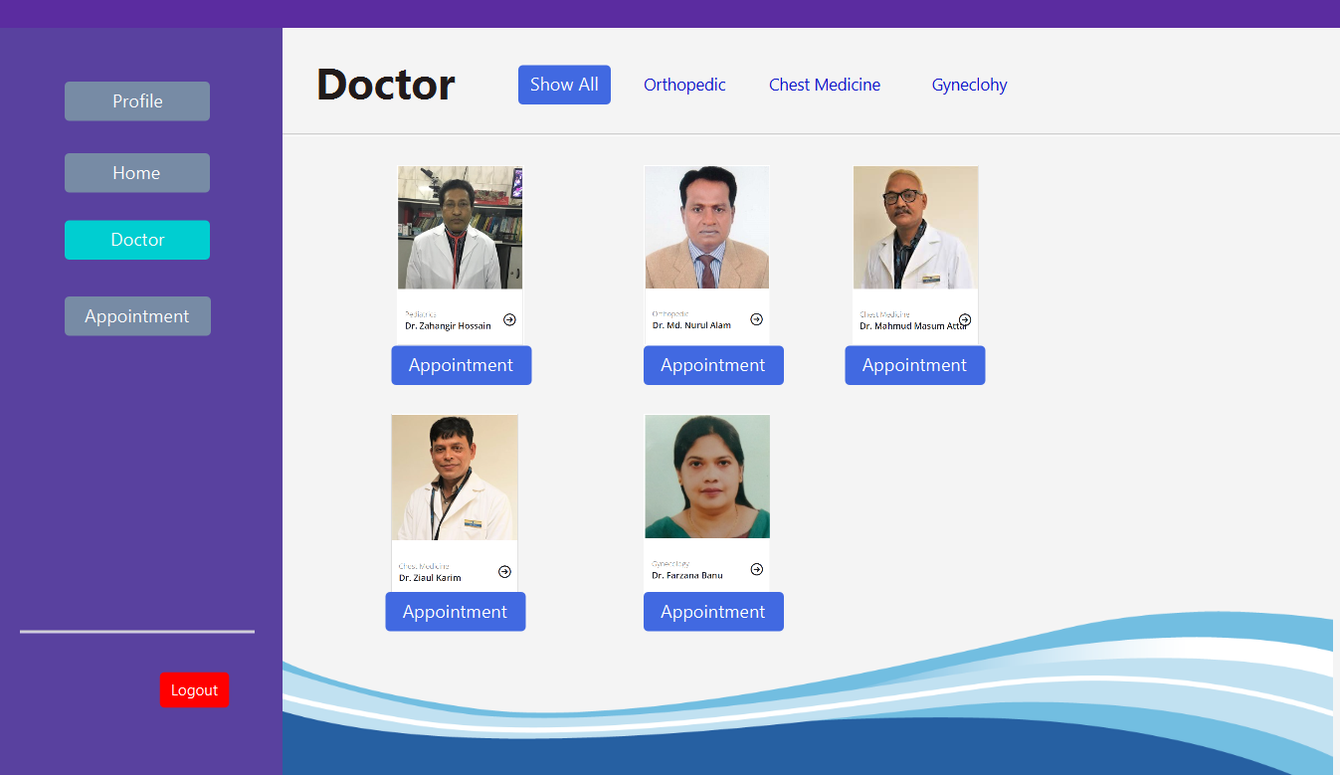
Doctor
This is the doctor menu. The patient can know the details about the doctor and he can get the appointment by clicking on the appointed button

Slide 5
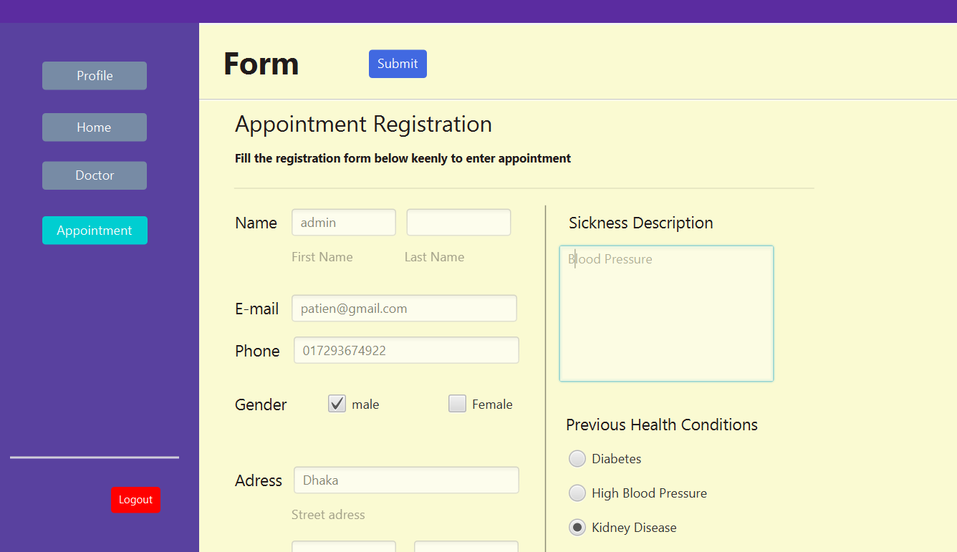
Appointment
User has to fill the form before getting appointment. After filling the form, clicking the submit button will open the chat menu

Slide 6
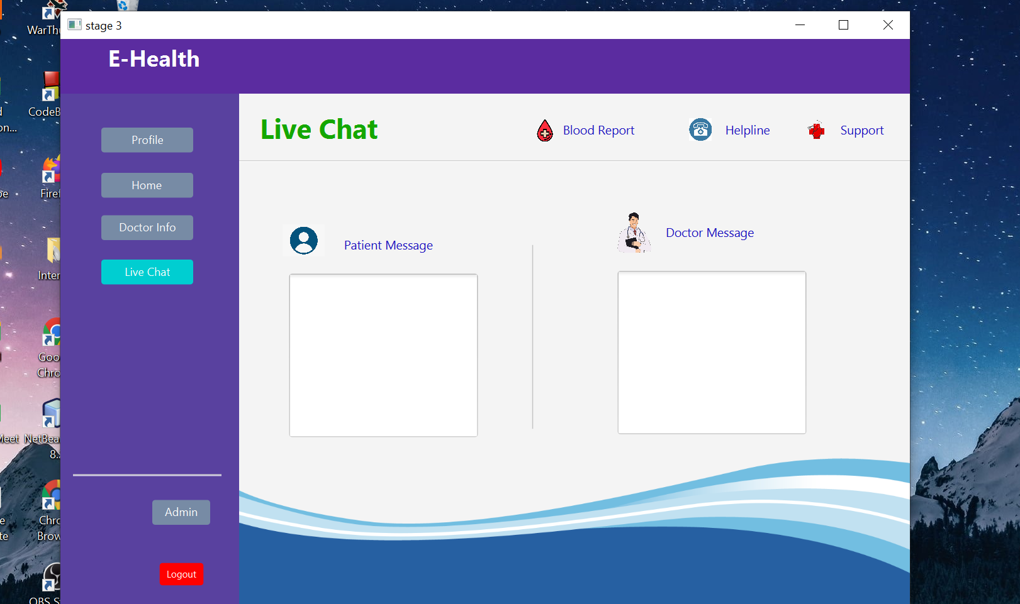
Live chat
Patients and doctors can chat with each other in the live chat section
The doctor can see the details of the patient and he will advise the patients

Slide 7

Thank you
If you have any question please feel free to ask

